Slide 1
Diseases of the Skin
By
Dr. Hussein AlNaji

Slide 2
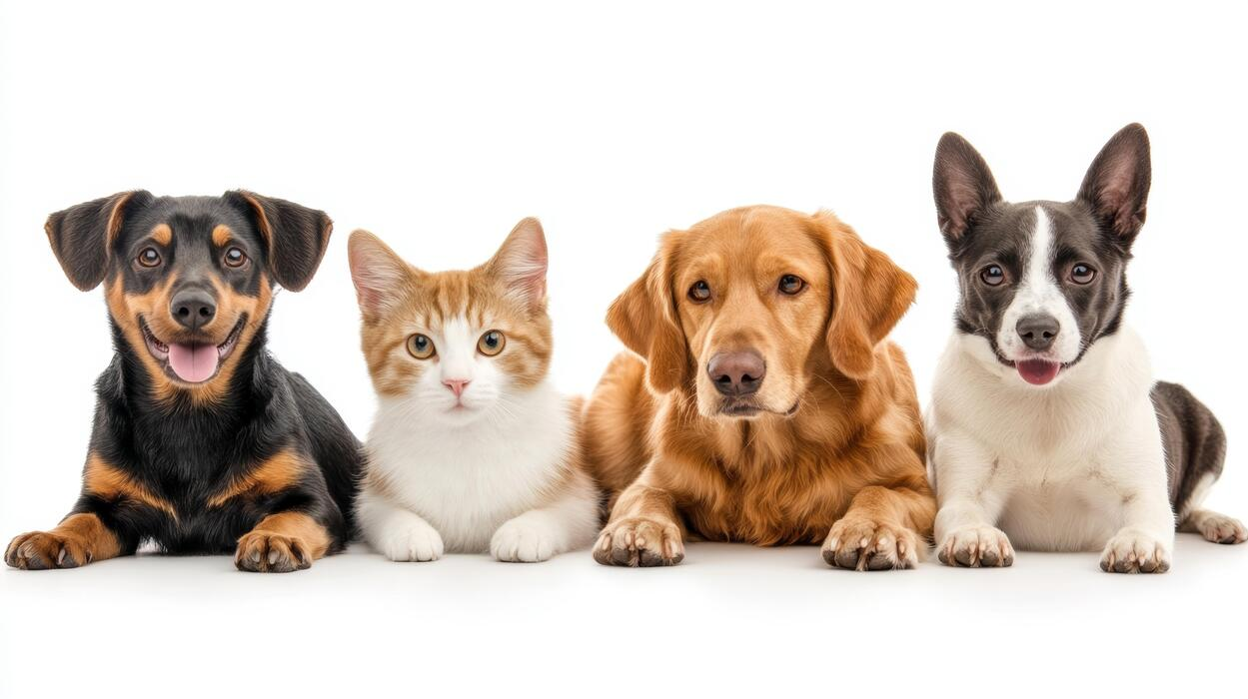
The major functions of the skin are:
To maintain a normal body temperature
To maintain a normal fluid and electrolyte balance within the animal
To create a mechanical barrier to protect the body from noxious agents and organisms
To act as a sensory organ perceiving those features of the environment that are important to the subject’s survival.

Slide 3
Primary/Secondary Lesions
Diseases of the skin may be primary or secondary in origin.
In primary skin disease the lesions are restricted initially to the skin, although they may subsequently spread from the skin to involve other organs. While cutaneous lesions may be secondary to disease originating in other organs.
Note: Differentiation between primary and secondary skin diseases should be attempted by seeking evidence that organs other than the skin are affected.

Slide 4
Clinical Signs and Special Examination
A general clinical examination is followed by a special examination of the skin and must include:
Inspection
Palpation.
Additional information can be obtained by taking:
swabs for bacteriologic examinations.
scrapings for examination for dermatophytes and metazoan parasites.

Slide 5
3- biopsy for histopathological examination. Biopsy material should include abnormal, marginal, and normal skin.
4. A Wood’s lamp finds a special use in the examination of the skin for dermatophytes.
5. Descriptions of lesions should include size, depth to which they penetrate topographic distribution on the body, and size of the area affected. Abnormalities of sebaceous and sweat secretion, changes in the hair or wool coat, and alterations in color and temperature of the skin should be noted, as should the presence or absence of pain.

Slide 6
Lesions
Scales: Dry flaky exfoliations
Excoriations: Traumatic abrasions and scratches.
Fissures: Deep cracks.
Dry gangrene: Dry, horny, black, avascular, shield-like.
Keratosis: Overgrowth of dry, horny, keratinized epithelium.
Acanthosis: Like keratosis but moist, soft.
Hyperkeratosis: Excessive overgrowth of keratinized, epithelium like
Scab.
Parakeratosis: Adherent to skin.
Eczema: Erythematous, itching dermatitis

Slide 7
Discrete lesions
Vesicle, bleb, bulla, Blister : Fluid (serum or lymph)-filled blister 1–2 cm diameter.
Pustule: Pus-filled blister, 1–5 mm.
Wheal: Edematous, erythematous, swellings, transitory.
Papules (pimples): Elevated, inflamed, necrotic center, up to 1 cm diameter.
Nodules, nodes: Elevated, solid, up to 1 cm diameter Acute or chronic inflammation. No necrotic center

Slide 8
Plaque: Larger nodule, up to 3–4 cm diameter.
Acne: Used synonymously with pimple but strict meaning is infection of sebaceous gland.
Impetigo: Flaccid vesicle, then pustule, then scab, up to 1 cm diameter.
Scab (or crust): Crust of coagulated, blood, pus, and skin debris.
Macule (patch): Small area of color change; patch is larger.

Slide 9
Abnormal Coloration
The parameter of abnormal coloration includes jaundice, pallor, and erythema. In animals these conditions are rarely visible in light-colored skins.
Early erythema is a common finding where more definite skin lesions are to develop, as in early photosensitization.
The blue coloration of early gangrene (e.g., of the udder and teat skin in the early stages of peracute bovine mastitis associated with Staphylococcus aureus) is characterized by coldness and loss of elasticity.

Slide 10
Pruritus
• Pruritus or itching is the sensation that gives rise to scratching.
• Hyperesthesia is increased sensitivity to normal stimuli.
• Paresthesia is perverted sensation, a subjective sensation, and not diagnosed in animals.
Common causes include the following.
Cattle and sheep
• Sarcoptic and chorioptic mange
• Lice infestation
• Nervous acetonemia

Slide 11
Horses
• Chorioptic mange on the legs
• Queensland (sweet) itch along the dorsum of the body
• Lice infestation
• Perianal pruritus from Oxyuris equi infestation.
Abnormalities of Wool and Hair Fibers
Deficiency of hair or wool in comparison to the normal pilosity of the skin area is alopecia or hypotrichosis.

Slide 12

THANK YOU

